Slide 1

Flood Guard: A Communication Platform for Enhanced Flood Disaster Management

Slide 2

Department of Computer Engineering DATTA MEGHE COLLEGE OF ENGINEERING ,AIROLI , NAVI MUMBAI - 400 708 University of Mumbai (AY 2024-25)
Team Members
Under the guidance of-
Roll No.
Names of members
Dr. J .R . Nandwalkar
42
Akanksha Jagtap
43
Ishika Jain
51
Sakshi Kakad
58
Arati Kokitkar

Slide 3

Topics To Be Discussed:
Introduction
Problem Statement
Literature Survey
Objectives
Proposed System
Limitations
Future work
References

Slide 4

Introduction
In today's world, natural disasters pose a significant threat to communities worldwide. To address this pressing issue, we propose Flood Guard, a communication platform designed to enhance flood disaster management.
Flood Guard empowers individuals and communities to stay informed, prepared, and safe during flood emergencies. By leveraging advanced technologies, our platform offers real-time flood alerts, weather updates, interactive maps, and an SOS feature to ensure timely assistance.
Through Flood Guard, users can receive timely notifications about impending floods, access real-time maps of affected areas, and stay informed about current weather conditions. The SOS feature allows individuals to send emergency alerts directly to authorities for immediate assistance. Additionally, Flood Guard facilitates community engagement by providing a platform for sharing information and coordinating response efforts.

Slide 5
Problem Statement
Floods are a major natural disaster that can cause significant damage to property, disrupt lives, and even lead to loss of life. Current methods of flood management often lack the necessary tools and communication channels to effectively respond to these emergencies. The Flood Guard communication platform aims to address these challenges by providing a comprehensive solution for flood disaster management. By leveraging advanced technologies, Flood Guard offers real-time flood alerts, weather updates, interactive maps, and a community engagement platform to empower individuals and communities to stay informed, prepared, and safe during flood events.
Improve flood preparedness and response efforts.
Reduce the impact of floods on communities.
Utilize technology to provide timely and accurate information.

Slide 6
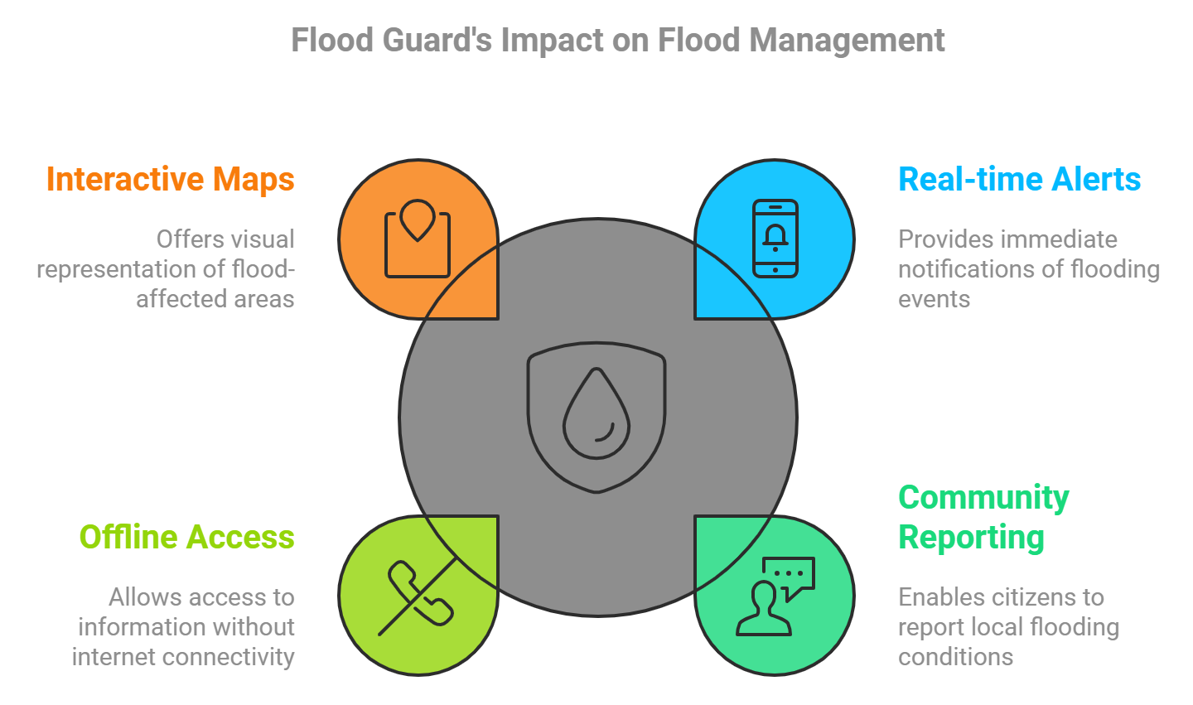

Slide 7
Literature Survey
Flood Early Warning Systems (FEWS):
FEWS minimize property damage and enhance preparedness by providing real-time forecasts and alerts. For instance, the Aqua Flood platform by Vassar Labs combines hydrological modeling and real-time data to generate accurate forecasts, thereby reducing economic losses and improving public safety [1] .
Decision Support Systems (DSS):
DSS tools integrate spatial hydrological models to analyze land use, climate change, and water resources for flood risk management. A case study in Italy demonstrated how integrating the SWAT model helps stakeholders make informed agricultural and flood management decisions by simulating future scenarios [2].
IoT-Based Flood Management Systems:
IoT technologies automate flood prevention by collecting environmental data from sensors. Research from the Mumbai floods of 2005 highlights how IoT networks can predict floods and manage wastewater systems with minimal human intervention, ensuring better disaster management[3].

Slide 8
Flood Level Monitoring System (FLMS):
The FLMS, developed for Kurla (Mumbai), utilizes machine learning to predict flood events by analyzing rainfall and water levels. As a web-based platform, it delivers real-time alerts to users and facilitates communication with emergency services, enhancing disaster response and community preparedness[4] .
Machine Learning in Flood Forecasting:
The use of machine learning algorithms trained on historical climate data has enhanced predictive capabilities for flood forecasting. These models improve decision-making by enabling authorities to issue timely warnings and plan proactive responses [5].
IoT-Cloud Integration for FEWS:
A proposed IoT-based flood early warning system collects rainfall, water level, and weather data in real-time and processes it on the cloud. This system ensures comprehensive monitoring of flood-prone areas, with alerts delivered through mobile apps, improving community preparedness and evacuation efforts
[6].

Slide 9
Objectives
1. Real-time Flood Alerts
The primary objective of the platform is to deliver real-time flood alerts to users. This is achieved by integrating with various data sources, such as river monitoring systems, rain gauges, and government alert services. Alerts are location-specific, ensuring that only users in affected areas are notified. Notifications are sent through multiple channels, including mobile apps, SMS, and email, to ensure that critical warnings are not missed.
2. Weather Updates
The platform offers continuous weather updates to keep users informed about changing conditions. Through the integration of trusted weather APIs, the system provides hourly, daily, and weekly forecasts, focusing on rainfall data that could potentially trigger flooding. Users will receive alerts about extreme weather events.
3. SOS Feature
A crucial aspect of the platform is the SOS feature, which enables users to send signals during emergencies. With one tap, users can broadcast their location and a predefined emergency message to selected contacts or local emergency services. This feature ensures a rapid response by connecting users directly to rescue teams or authorities. The SOS feature will still work via SMS. This functionality ensures that users are not left stranded even when networks fail.

Slide 10
4. Interactive Maps
The platform includes interactive maps that offer users visual insights into flood-prone areas, evacuation routes, and nearby shelters. These maps are dynamically updated with real-time data on water levels, road blockages, and flooded zones. Users can also contribute to the map by reporting floods or hazards they encounter, which is validated by other users or authorities.
5. Integration with Emergency Response Systems
Seamless integration with local emergency response systems is essential for coordinated disaster management. The platform connects with government disaster management authorities, rescue teams, and emergency services to share critical data and automate responses. For example, SOS alerts sent by users can trigger immediate dispatch of rescue operations. This coordination ensures that emergency responders have real-time access to flood maps, user reports, and affected areas, improving the efficiency of relief efforts.
6. Community Engagement and User Reporting
The platform promotes community engagement by allowing users to report local floods, blocked roads, and hazards through the app. Verified reports are displayed on the interactive map, providing valuable information for both users and authorities. A forum feature allows users to share experiences, tips, and solutions for flood-related challenges.

Slide 11
7. Data Analytics for Prediction and Planning
In addition to real-time alerts, the platform leverages data analytics to predict future flood risks and aid in long-term disaster planning. Machine learning models analyze historical weather data, water levels, and rainfall patterns to forecast flood events. These insights are shared with government agencies and local authorities to enhance preparedness and mitigation strategies. The analytics module also tracks user behavior, such as response times to alerts, to improve the platform’s effectiveness.
8. Security and Privacy Compliance
Ensuring the security and privacy of users is a critical objective of the platform. All communication, including SOS alerts and personal information, is encrypted to prevent unauthorized access. The platform complies with data privacy regulations, such as the General Data Protection Regulation (GDPR), ensuring users data is handled responsibly. Users are also given control over their personal data, allowing them to manage who receives their emergency information, fostering trust in the platform.

Slide 12
Proposed System
The Flood Guard Communication Platform is a comprehensive solution for managing flood emergencies, focusing on delivering real-time alerts and facilitating effective communication. It employs multi-channel notifications—such as SMS, email, and push alerts—to ensure users receive timely flood alerts and weather updates. The platform features interactive maps that display affected areas and allow users to report blocked routes, enhancing situational awareness. Additionally, an SOS feature enables users in distress to send real-time alerts with their GPS location to emergency responders and trusted contacts, ensuring prompt assistance during critical situations.
For preparedness and response, the platform integrates with emergency response systems, facilitating seamless communication between authorities, rescue teams, and those affected. A key advantage of the system is its offline functionality, which allows access to cached maps and the ability to send SOS alerts via SMS. Moreover, the platform promotes community engagement through a forum for sharing flood-related information. By combining real-time alerts, emergency communication, and community participation, the Flood Guard Communication Platform enhances safety and preparedness in flood-prone areas.

Slide 13
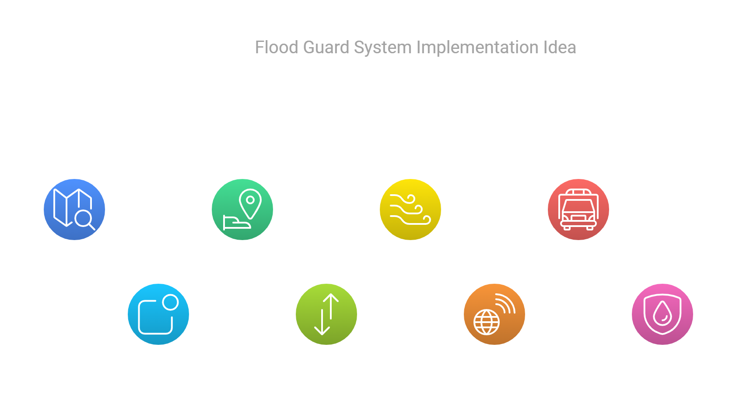

Slide 14
Flowchart
Start
Weather Data
Flood Guard analyze weather data
Flood condition detected ?
Yes
No
Send SMS alert to user
User stuck in flood ?
No
Yes
Receive SOS with live location of user
Send user location to volunteers or authorities
End

Slide 15
Limitations
Dependency on User Participation
The platform’s effectiveness in hazard reporting relies heavily on user engagement, which may be inconsistent in some areas.
Scalability Issues
Scaling the platform to serve larger populations or multiple regions may require infrastructure upgrades and further optimization.
Dependence on External Collaboration
Successful integration with emergency response services and government agencies may face delays or challenges due to policy or technical barriers.
Data privacy concerns:
Collecting user location and personal data for real-time tracking and alerts could raise privacy concerns.
Potential for Misuse of Features:
Users might misuse the SOS feature, leading to unnecessary strain on emergency services and diminishing the credibility of genuine alerts.

Slide 16
Challenges with Offline Functionality
While SMS-based SOS and cached maps help during outages, the full functionality of the platform still requires internet connectivity for updates.
Initial Setup and Maintenance Costs
Establishing multi-channel communication and integrating with emergency services may require significant resources and collaboration efforts.
Potential Data Overload
High volumes of user reports during emergencies may overwhelm the system, requiring efficient filtering and prioritization mechanisms.
Limited Precision of User-Reported Data
User-submitted information, like hazard reports, might be inaccurate or incomplete, affecting the quality of situational awareness.

Slide 17
Future work
1. Integration of Advanced AI Models for Flood Prediction
Implement machine learning models, such as neural networks or ensemble models, to improve flood prediction accuracy based on historical weather data, satellite imagery, and sensor data (if added in the future).
Incorporate deep learning models for image analysis to detect flood-prone areas in real-time from satellite images or drone footage.
2. Crowdsourced Data for Enhanced Reporting
Add functionality for users to report on-the-ground flood conditions, such as rising water levels, blocked roads, or damaged infrastructure, to supplement system alerts.
Implement a reward or recognition system for users who provide accurate, timely reports, encouraging community participation.
3.Integration with Government and Emergency Systems
Establish connections with local government disaster response teams, allowing seamless communication between the Flood Guard system and public authorities.
Enable automated alerting to emergency services when SOS messages are triggered, ensuring faster response times and effective coordination with rescue operations.

Slide 18
4. Multi-language Support and Accessibility Features
Extend the system’s functionality to support multiple languages, making it more accessible to users in different regions or countries affected by floods.
Incorporate accessibility features such as voice alerts for visually impaired users or simplified interfaces for those with limited technical skills.
5. Prediction of Secondary Disasters
Integrate the system with models that predict secondary disasters caused by floods, such as landslides or infrastructure collapse, providing users with more comprehensive safety information.
6. Mobile App Enhancement with Offline Capabilities
Develop an offline mode for the mobile app that can store critical information about safe routes, emergency contacts, and survival tips in case of network outages during floods.
Incorporate features like offline mapping and SOS functionality that uses SMS when internet connectivity is lost.
7. Real-time Traffic and Evacuation Route Suggestions
Integrate real-time traffic data and provide optimal evacuation routes for users to avoid congested or flooded areas, ensuring safer and faster movement during evacuation.
Use algorithms to calculate and display the shortest and safest paths based on flood conditions and road closures.

Slide 19
References
[1] A. Bhattacharya, R. Sharma, and S. S. Shukla, "A comprehensive review of flood prediction models using machine learning and deep learning," IEEE Access, vol. 10, pp. 12345-12360, 2022. doi: 10.1109/ACCESS.2022.3181675.
[2] S. Asadi and M. K .Khosravi, "Development of an IoT-based flood monitoring and early warning system using wireless sensor networks," IEEE Sensors Journal, vol. 22, no. 1, pp. 876-884, Jan. 2022. doi: 10.1109/JSEN.2021.3078226.
[3] S. Jha, D. Gupta, and M. Gupta, "Flood management system using cloud computing and Internet-of-Things," IEEE Access, vol. 10, pp. 10146661, 2021. doi: 10.1109/ACCESS.2021.10146661.
[4] V. Jadhav and S. Ghosh, "Flood location, management, and solution (FLMS): A flood prediction and management system for Kurla," IEEE Access, vol. 10, pp. 10392346, 2021. doi: 10.1109/ACCESS.2021.10392346.
[5] V. Agarwal and A. Agrawal, "Flood forecasting using machine learning: A review," IEEE Access, vol. 9, pp. 9528099, 2021. doi: 10.1109/ACCESS.2021.9528099.
[6] M. S. Khan, F. Jabeen, and H. A. Khattak, "IoT-based flood early warning system for effective disaster management," IEEE Access, vol. 10, pp. 10559355, 2021. doi: 10.1109/ACCESS.2021.10559355.

Slide 20
THANK YOU !!

